Slide 1
Actionable Insights for Hotel Reservations
IST-687 Final Project Presentation
By Yeling Cai, Yunhan Zhang, Zekai Wei

Slide 2
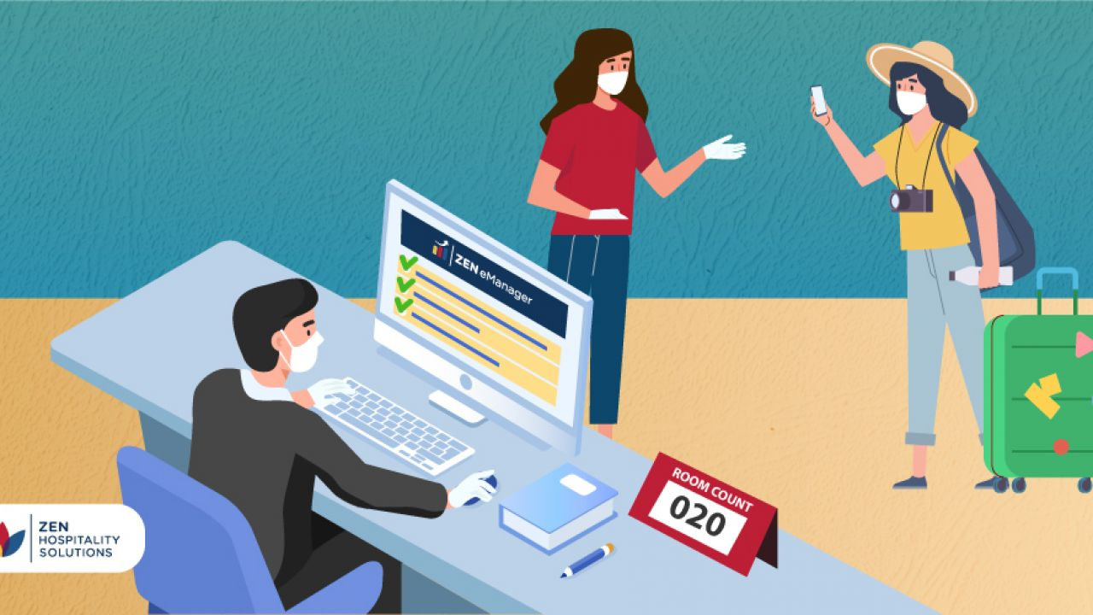
To the managers:
Many customers will cancel their completed hotel reservations for various reasons. These cancellations will cause negative effects to the hotel and even to the hotel revenues. By using technical of data analytics, we are able to understand some key drivers for why customers cancel their reservations and better predict who will mostly to cancel in the future. By the end, there will be some substantive recommendations to the managers.

Slide 3
All Key Drivers
Lead time
Stay in weekend & weeknights
Adults & children & babies
Meals
Countries
Market segment
Repeated guest
Previous cancellations
Previous booking not cancelled
Reserved room type & Assigned room type
Booking changes
Deposit type
Customer type
Required parking spaces
Special requests

Slide 4
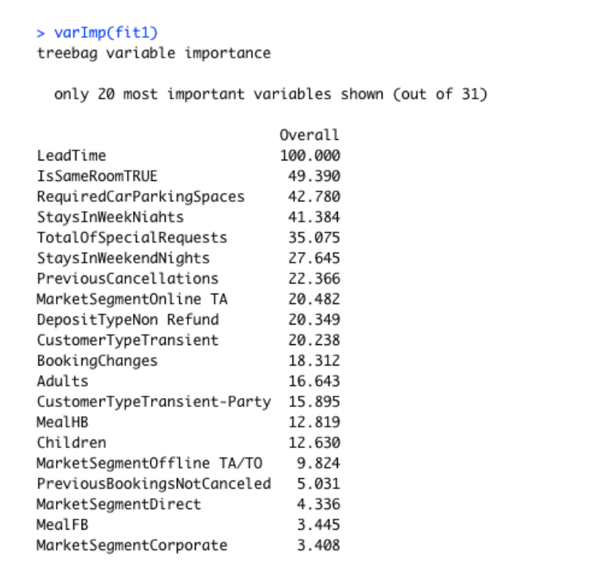
The most important Key Drivers
Lead time
Reserved room type & Assigned room type
Required parking spaces
Previous cancellations
Booking changes
Deposit type
Customer type

Slide 5
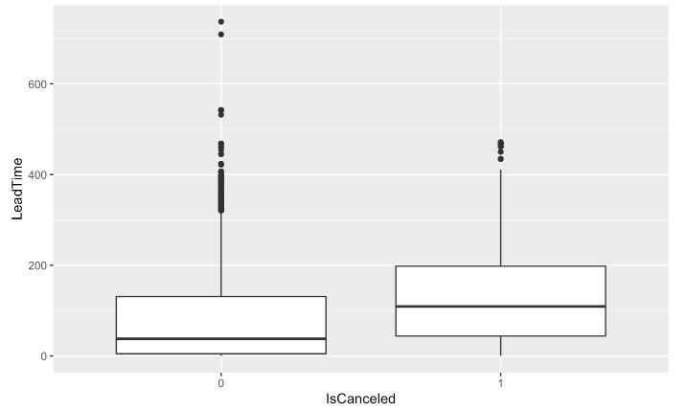
Meaningful Data Visualization - Lead Time

Slide 6
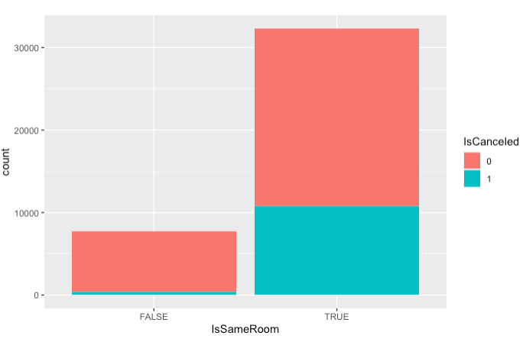
Meaningful Data Visualization - Is Same Room

Slide 7
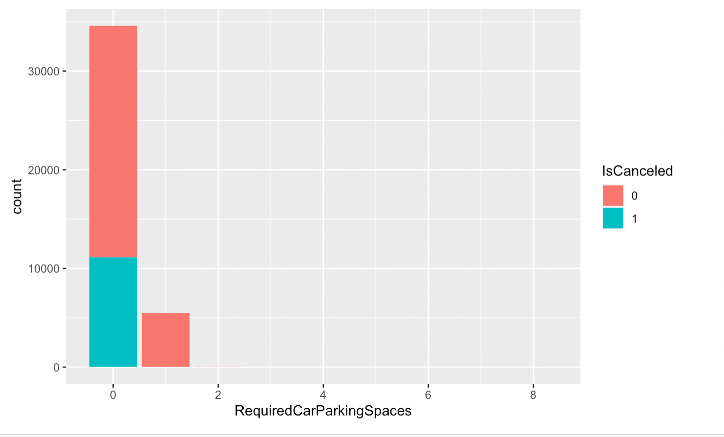
Meaningful Data Visualization - Required Parking Spaces

Slide 8
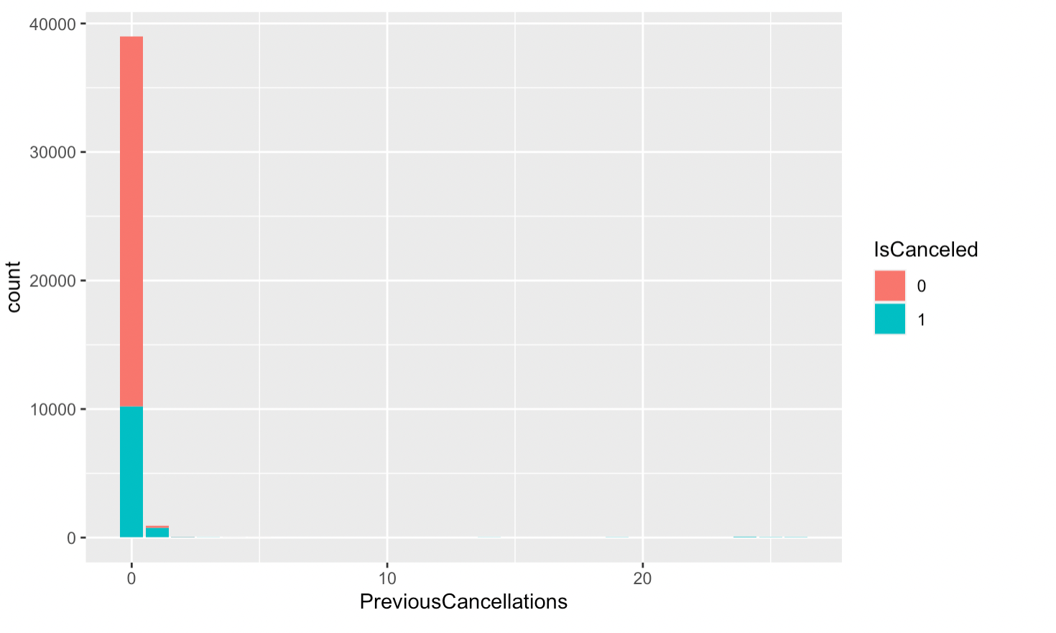
Meaningful Data Visualization - Pervious Cancellations

Slide 9
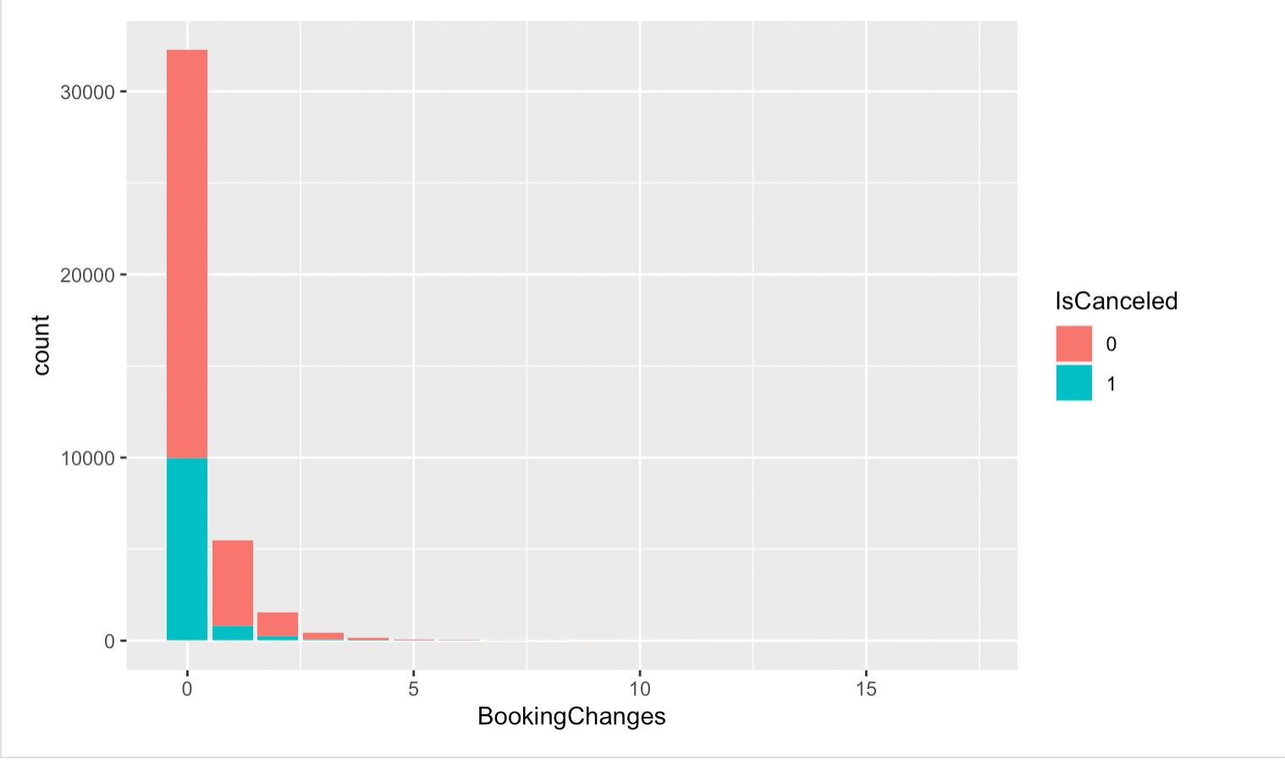
Meaningful Data Visualization - Booking Changes

Slide 10
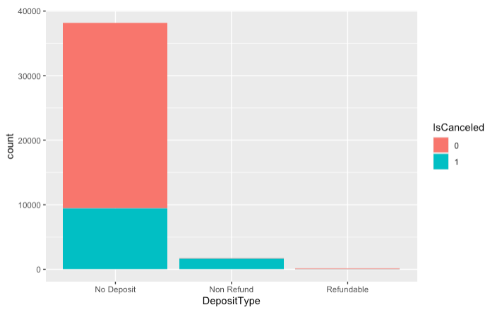
Meaningful Data Visualization - Deposit Type

Slide 11
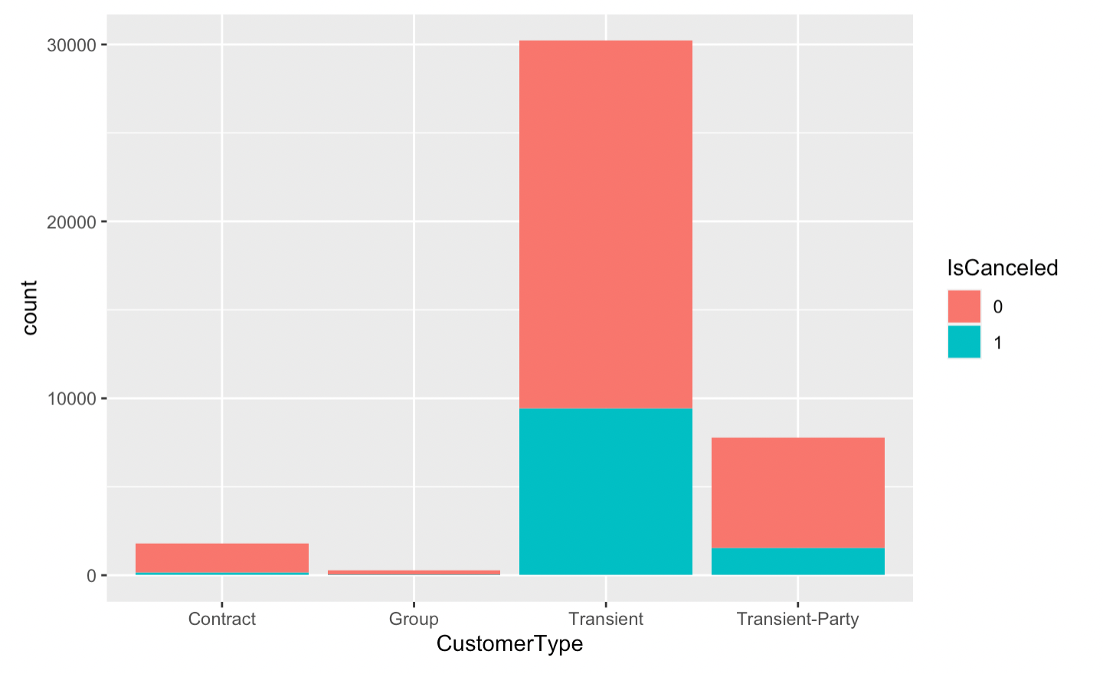
Canceled vs Non canceled Customer Type

Slide 12
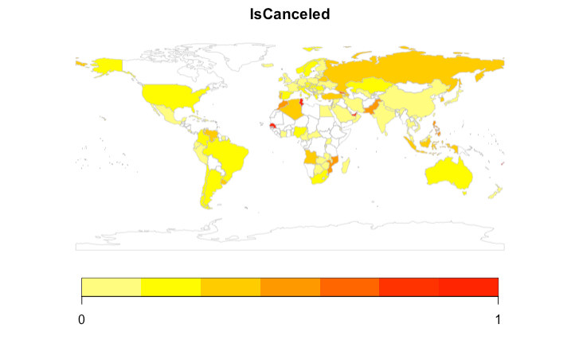
Mapping

Slide 13
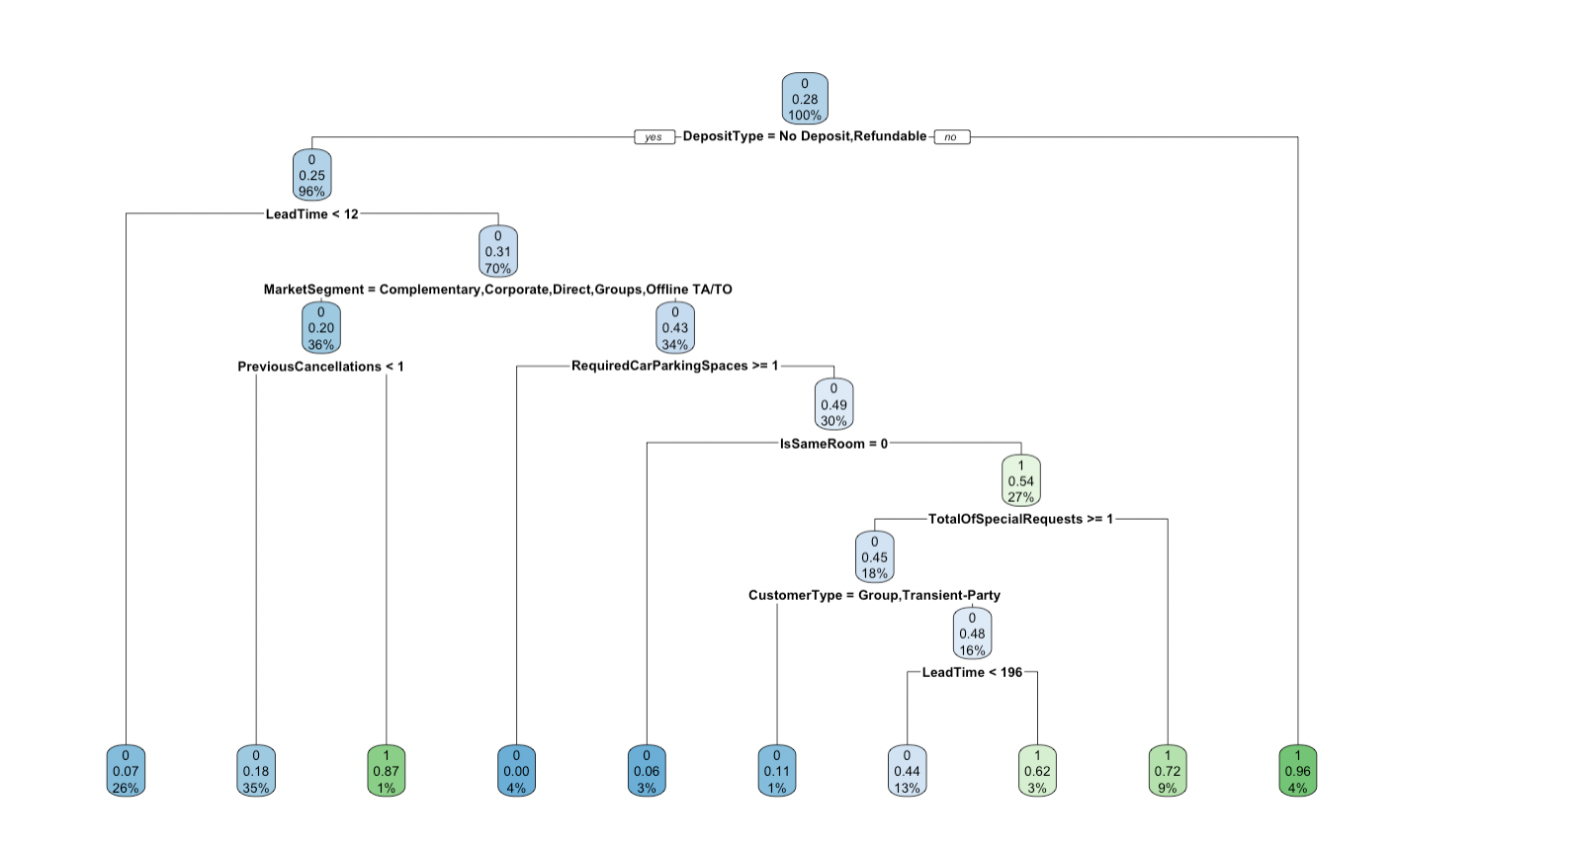
Machine Learnings #1 - Regression Tree

Slide 14
Machine Learnings #2 - SVM
Support Vector Machines (SVM) is another supervised machine learning algorithm. It is a kind of generalized linear classifier for binary classification of data. Its decision boundary is the maximum margin hyperplane of learning samples. SVM can be used for nonlinear classification by kernel method. Therefore, for the second model, we used SVM to predict the cancellation of guests.

Slide 15
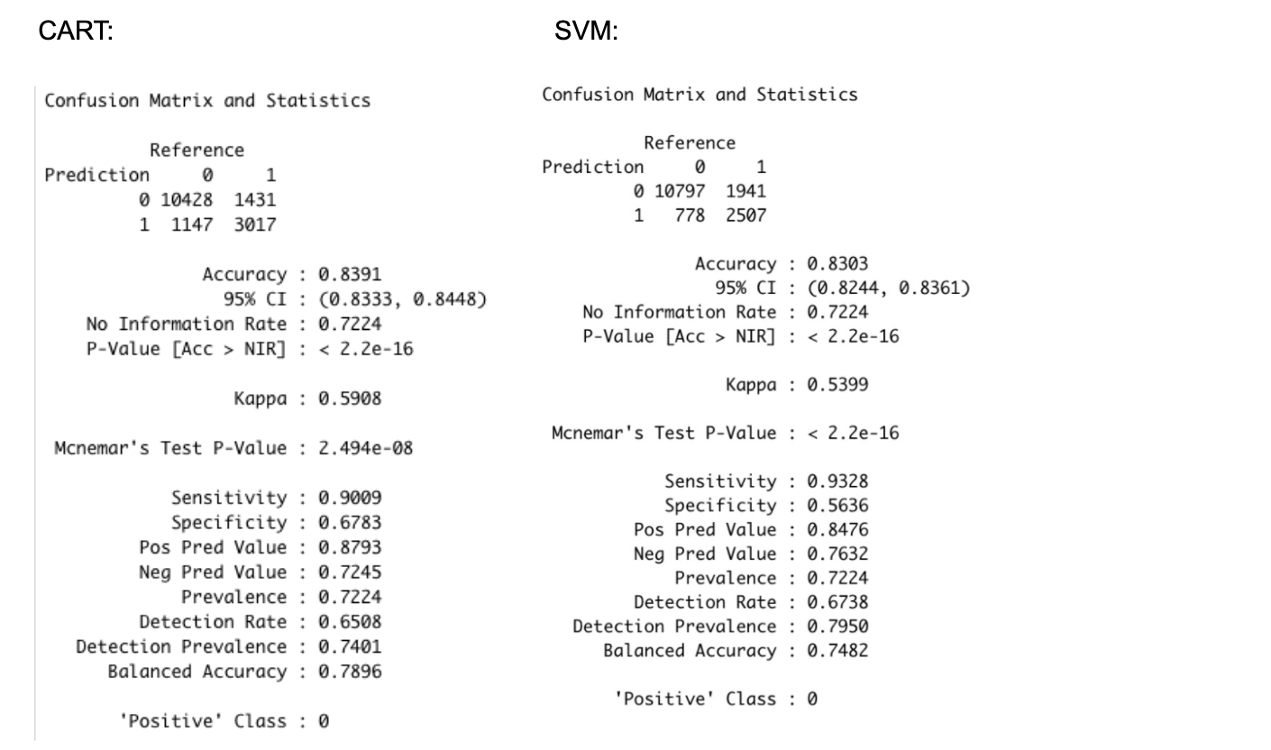
So which one is more accurate?

Slide 16
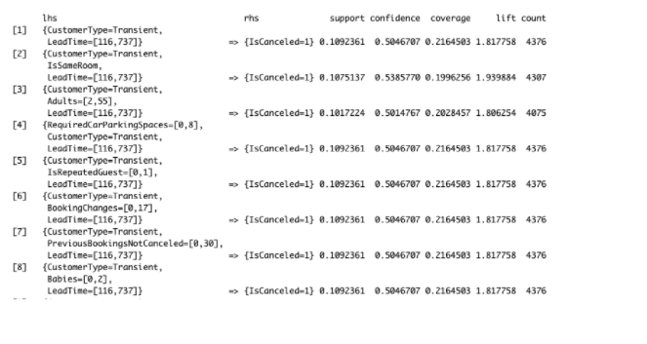
+Associative Rules Mining
Associative Rules Mining is one kind of unsupervised machine learning algorithms. It can be used to discover meaningful connections hidden in large data sets.

Slide 17

Recommendations!
Lead Time
Is Same Room
Car Parking Space
Customer Type

Slide 18
Thank you for listening.
We wish you the best of luck!

